Slide 1
TDD with ChatGPT
Llewellyn Falco
Notes:
https://chatgpt.com/c/724739f2-321d-455b-b882-84645a21c626

Slide 2
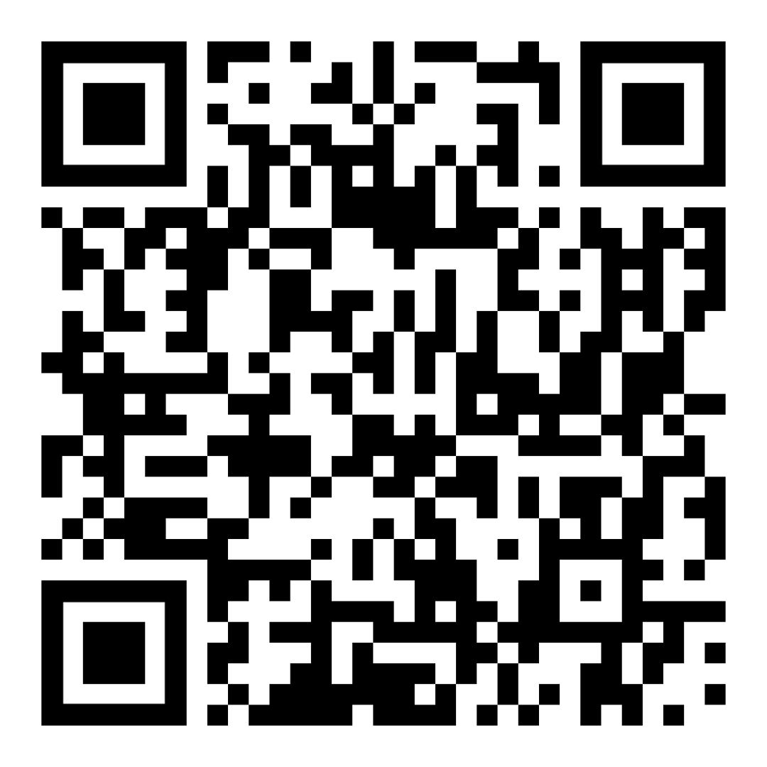
Resources
https://github.com/isidore/Talks/blob/master/TddWithChatGpt
Notes:
https://github.com/isidore/Talks/blob/master/ChatGPTPrompting.md

Slide 3
Today is May 31th 2024 – 3:40 pm CET

Slide 4
New Technology & Battle

Slide 5


Slide 6


Programmer of 2022
vs
Programmer of 2025

Slide 7
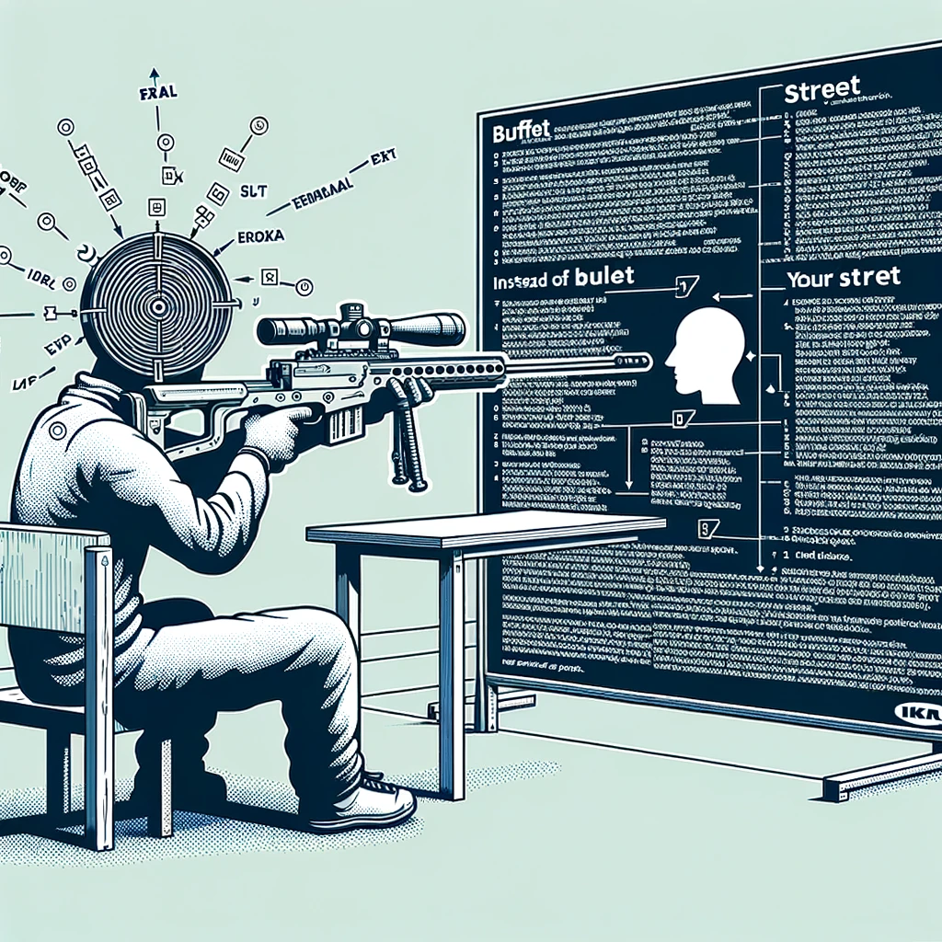
Concept Zero Shot Prompting

Slide 8
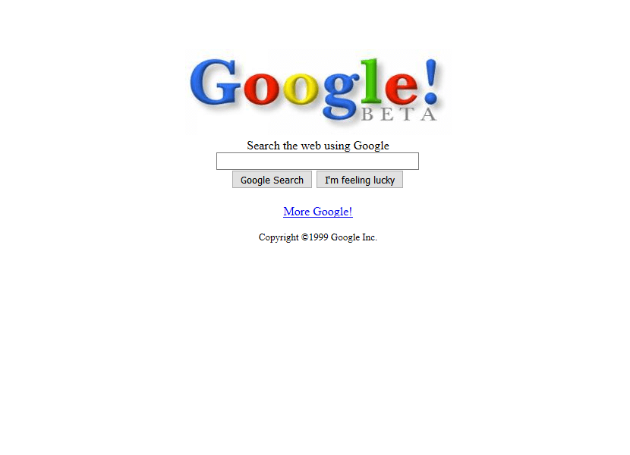
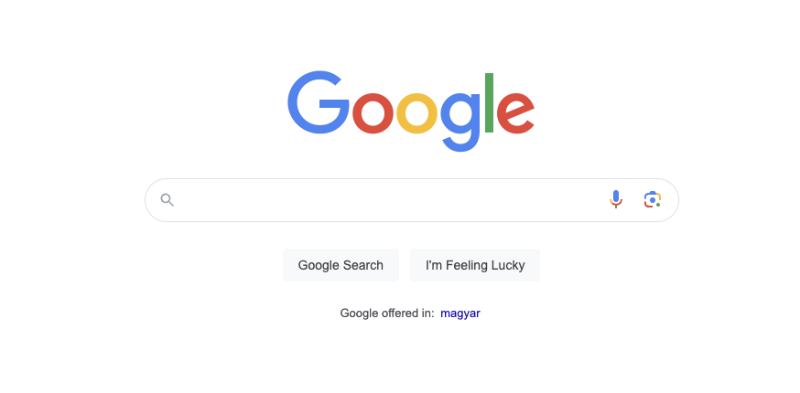
1999
2024
27,000 Programmers
&
25 years later

Slide 9
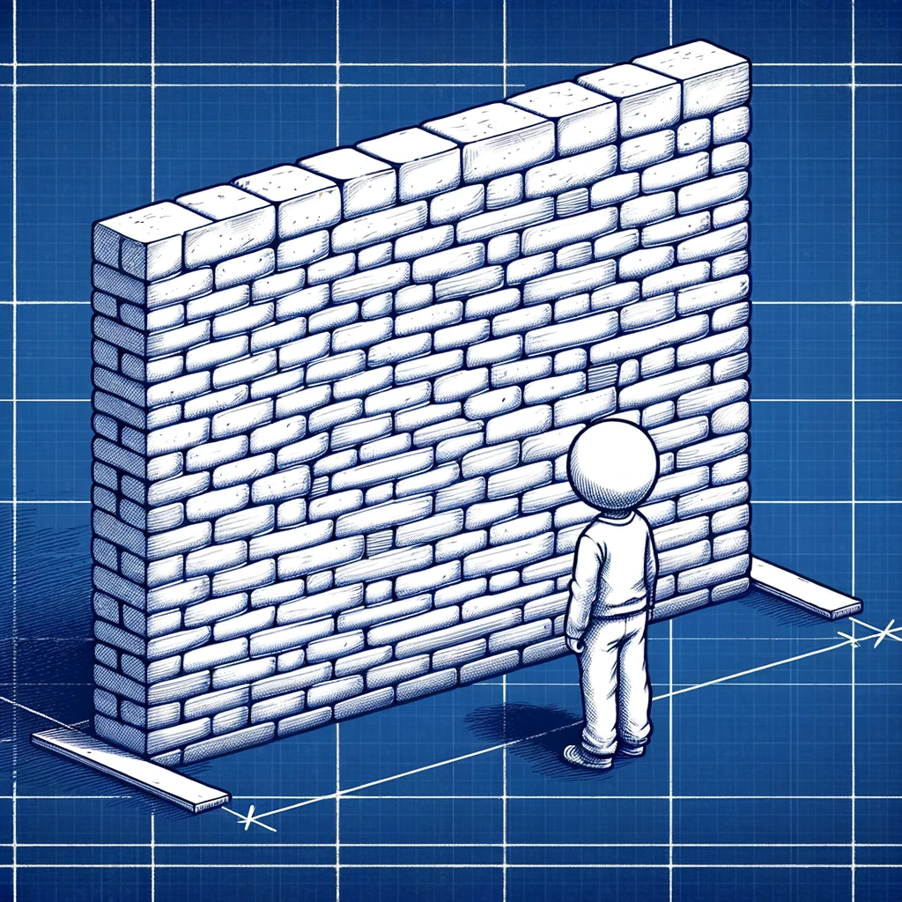
Concept The Wall
?
?
?
?

Slide 10

Hackea (Hack + Ikea) &Other ways of getting what you want

Slide 11
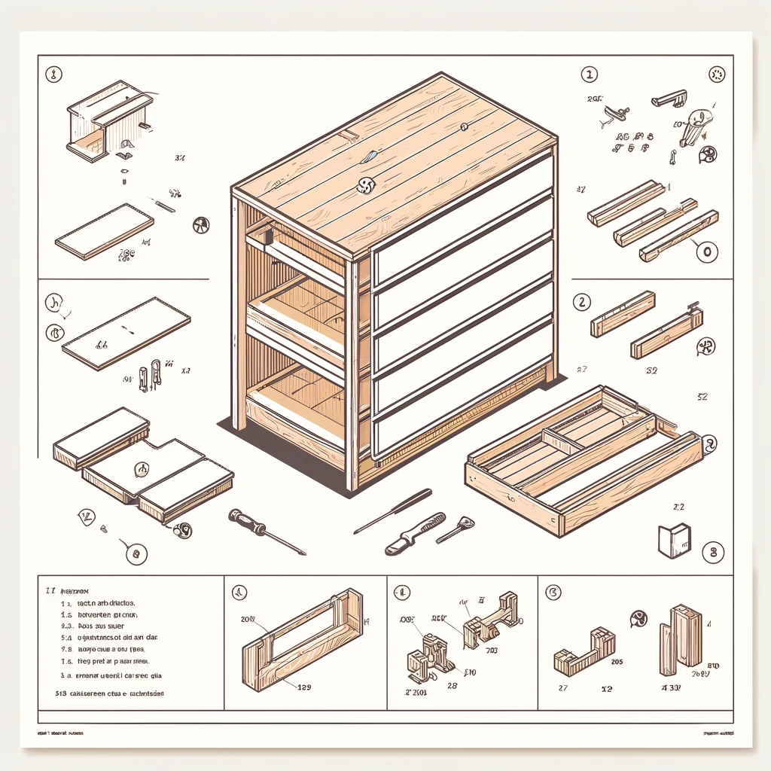
Parts Some assembly required

Slide 12

Concept Markdown
# Header 1
## Header 2
Inline `code` example **Bold:** text
*Italic:* text

Slide 13
#3 TDD & the 4 benefits of tests

Slide 14
1. Specification
2. Feedback
3. Regression
4. Granularity
- what am I going to write?
- did it work?
- does it still work?
- why did it stop working?
The 4 Benefits of Tests

Slide 15
Concept GitHub Co-pilot really good autocomplete
I can | complete your thoughts.

Slide 16
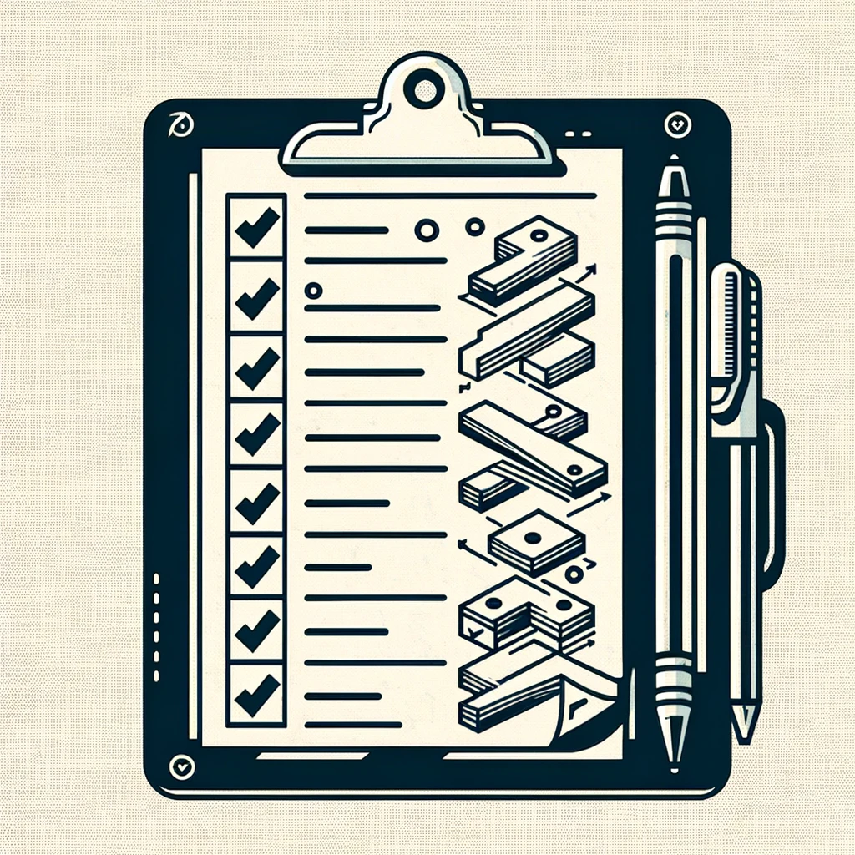
Concept Multi-step Prompt Here’s the plan, Here’s the details

Slide 17
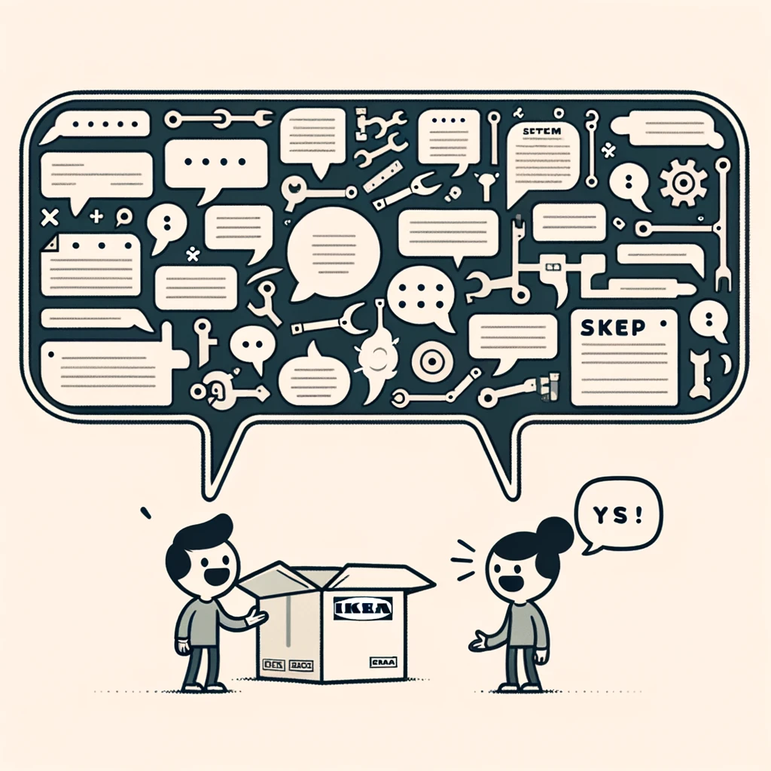
Concept Just the code no explainations

Slide 18
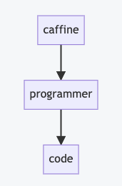
Concept Mermaid
```mermaid flowchart caffine --> programmer
programmer --> code ```

Slide 19
# Layers of Indirection

Slide 20
Steps
Products & Prices
Store
Items in cart
Unit Test
Shopping Cart
Invoice
1 book @ $10 50% off
Discounts
Discount Calculator

Slide 21
Steps
Products & Prices
Store
Items in cart
Unit Test
Shopping Cart
Invoice
1 book @ $10 50% off
Discounts
Discount Calculator
2 book @ $10 buy 1 get one free

Slide 22
Steps
Discounts
Unit Test
Discount Calculator
1 book @ $10 50% off
2 book @ $10 buy 1 get one free

Slide 23
# G
# P
# T

Slide 24
# Generative
# Pretrained
# Transformer

Slide 25
# Code Transformations

Slide 26

?

Slide 27
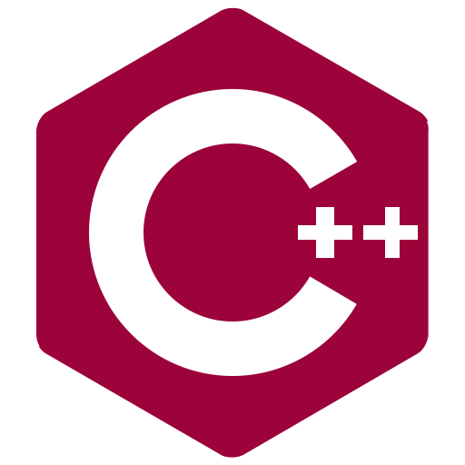


Slide 28

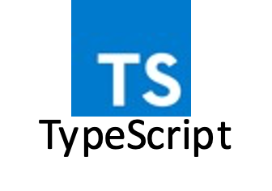

Slide 29
Existing Library (any language)
Your
Language

Slide 30
Code for
Single case
Code for
Multiple Cases

Slide 31
Safety & Knowing if something works

Slide 32
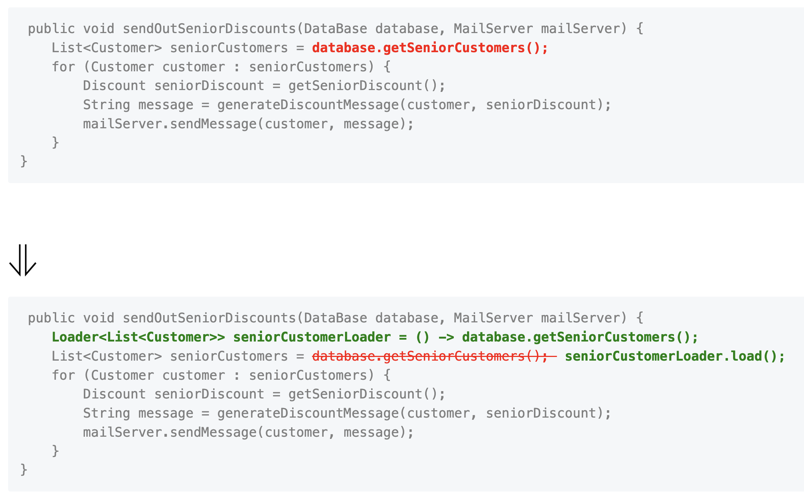

Slide 33
#1 Zero Shot Make it so…

Slide 34
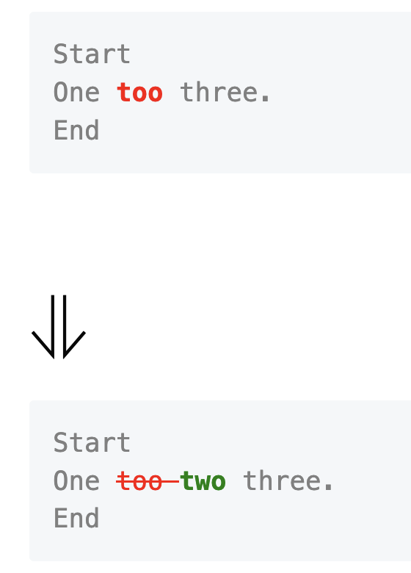
Please write some java code that will compare two string, and return a list of the differences between the two strings. I would like the API to be as follows: ```java Line[] lines = Diff.of("Start\nOne too three.\nEnd", "Start\nOne two three.\nEnd"); String markdown = MarkdownRender.refactoringsOf(lines); ``` Which would produce: ```markdown <pre style="color: gray"> Start One <b style="color: red">too </b>three. End </pre> # ⇓ <pre style="color: gray"> Start One <s style="color: red">too </s><b style="color: green">two </b>three. End </pre> ```

Slide 35
#2 Zero Shot, Take Two Maybe this time?

Slide 36
# Overview | | | |-------|----------------| | start | one too three. | | end | one two three. | Give a starting line, and an ending line, I would like to be able to describe the changes between the two lines. Please write a python implementation of the Line class ### Desired API ```python line = Line.of("one ").removed("too ").added("two ").and("three.") ``` ### Additional Requirements Please make the Line class immutable. If the state needs to change, create a new instance of that class. Also, please design to the class to be dynamic with the number of changes that might occur in a line.

Slide 37
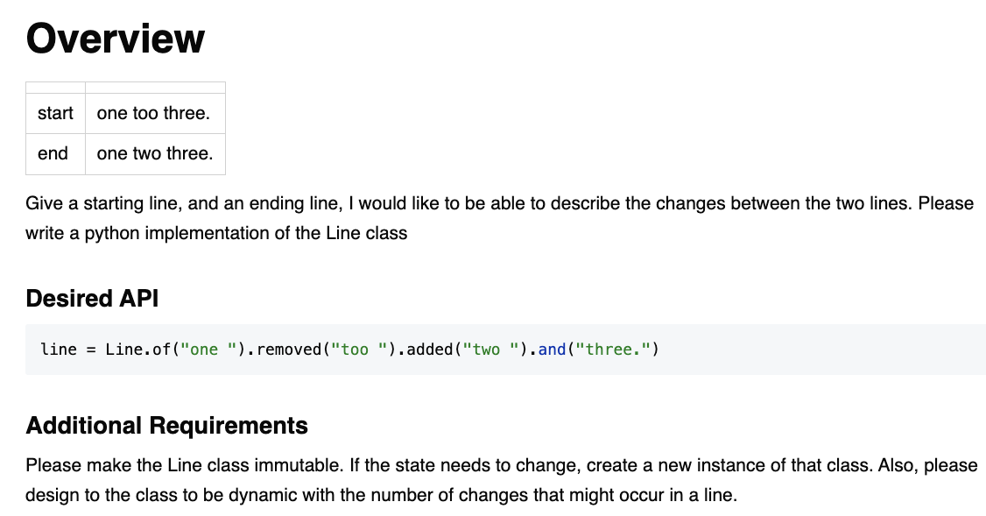

Slide 39

Resources
Thank you!
Llewellyn Falco
Please connect on LinkedIn
https://github.com/isidore/Talks/blob/master/TddWithChatGpt
Notes:
https://github.com/isidore/Talks/blob/master/ChatGPTPrompting.md

